Slide 1

Input-Output-Variables
Java s05
Kia Babashahi Ashtiani

Slide 2
Outline
Syntax and semantic
Libraries and packages
Primitive types
Errors
Camel Case
Reading Input
Formatters
Arithmetic and logical operations

Slide 3
Syntax
Syntax is defined on a computer language.
Set of rules that construct the expressions and statements in a programming language.
Syntax Errors usually happen when this is violated.

Slide 4
Semantics
What the program does.
It can be understood once the syntax works properly.

Slide 5
Java Libraries and packages
You have seen how to group classes into packages.
Let's say some one has created a set of classes that deal with math and put them in one package.
What if we can use their implementation instead of re-inventing the wheel?
This way you will be importing a package you or someone else has designed.

Slide 6
Packages and libraries
Programming languages designers have a set of these classes efficiently implemented.
You can use them by importing them. They are called Java libraries .
A collection of non-volatile resources computer programs use.

Slide 7
More on primitive Variables
Primitive types are embedded in the system. No need to call a library.
When defining a variable:
First, declare its type.
Second, give it a name.
Finally initialize it.
int num1=0;
double x=2.874;
char y=‘a’;

Slide 8
Rules to remember
Variable names are case sensitive.
Careful to define each variable only once.
You can not have int a=3 and int a=4; Why? The memory is already allocated to something of integer size named a. Instead of re-defining it put something different inside.
int a=3;
a =4; (The machine understands that this is the same int a).
Re-using is sometimes very nice ☺;

Slide 9
Put things together
We would like to create some variables.
Store some values inside of them and then print them.
To start with let's define one integer variable, one double variable, one char and one Boolean variable and then print them.

Slide 10

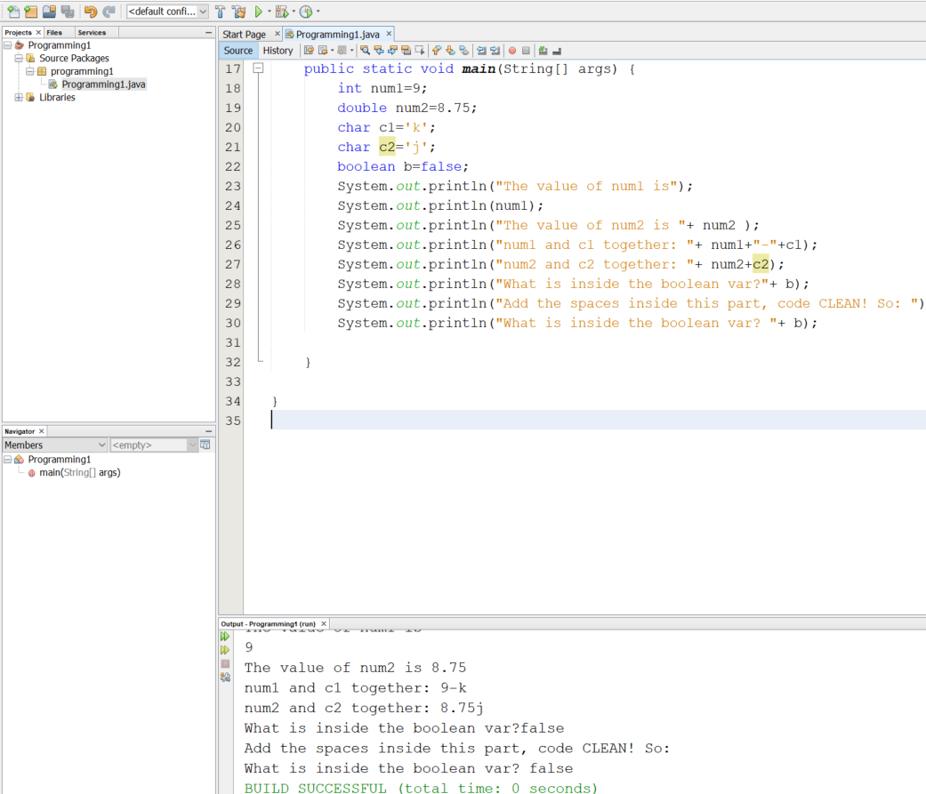
Code these play with them
What is being printed is of a String format do not forget that

Slide 11
Type of Errors
Compile time
Runtime

Slide 12
Compile time errors
They are usually caused by some violation of the syntax of the language.
The appear once you are coding and will not allow you to compile the code successfully.

Slide 13
Run time or execution time errors
The happen once the code is being executed.
Examples:
Open a file that does not exist.
Divide a number by zero.
….

Slide 14
Some common compile time errors.
Inserting the wrong type of element in a variable int a=3;a=4.5;
Forgetting the ;
There is a way to cast an integer to a double and you will learn it in the future.

Slide 15
How to name the variables.
Each programming language follows a specific format.
For Java it is very important to respect the naming schemas.
Helps other team members, the analysts and others read and understand your code better and faster.

Slide 16
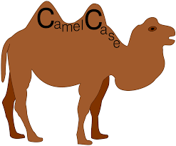
Camel Case
Picture is taken from
Variables: All the letters of the first word are in lower case. Any following word, has its first letter in Upper case and the rest in lower case:
myNum, firstString, studentId,studentName,…
Methods: Similar to variables but has a () at the end.
sumInt(), printString(), findAvg(),….
Classes: Look at the camel ☺

Slide 17
Variable naming
Variables names should not contain:
Space,
Special characters (!,@,”,}, ], …),
They should not be only numbers int 124=5 is incorrect.
They can be
String/char without space: name, studentName, I, j , count.
A string with component separated via an underline: student_name, department_id(python notation)
Combination of letters and numbers without space. Num1, mydog2, pizza4, temp33.

Slide 18
Read into variables→ Input
First tell the machine that we are going to import and use the package that deals with reading from the user. Yes! This one is not automatically imported.
If you forget to import the package you want to use, the machine can not find the instructions you wrote using the commands found in that package.

Slide 19
Input cont.
Remember to always declare the type first.
int firstNum,
Dog d,
cat c,
double secondNum.
To store the input we first need to read from the user and store what we read
Scanner input=new Scanner(System.in);

Slide 20
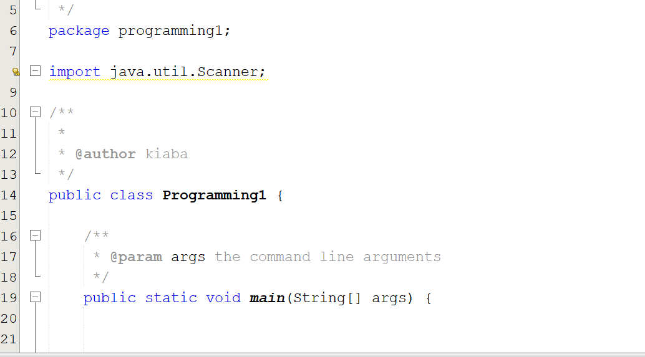
First input
Make sure to write the import statement.

Slide 21
What was that ?
Scanner input = new Scanner(System.in);
Scanner is the type.
Input is the name of the variable.
The variable is designed to read from the user, so it is “initialized” using system.in. (A new object of class scanner is created).
So here you are creating a cup that has the capacity to read from the input.

Slide 22
Input
You know you need a cup. What type of cup? Is it a plastic one? A glass one a metal one? In other words what type of data will be stored in this cup?
int firstNum= input.nextInt();
From now on you can read as many integers you need using the input.nextInt() function.
Int secondNumber=input.nextInt();
You should not read chars, Strings, Doubles using the same input object.

Slide 23
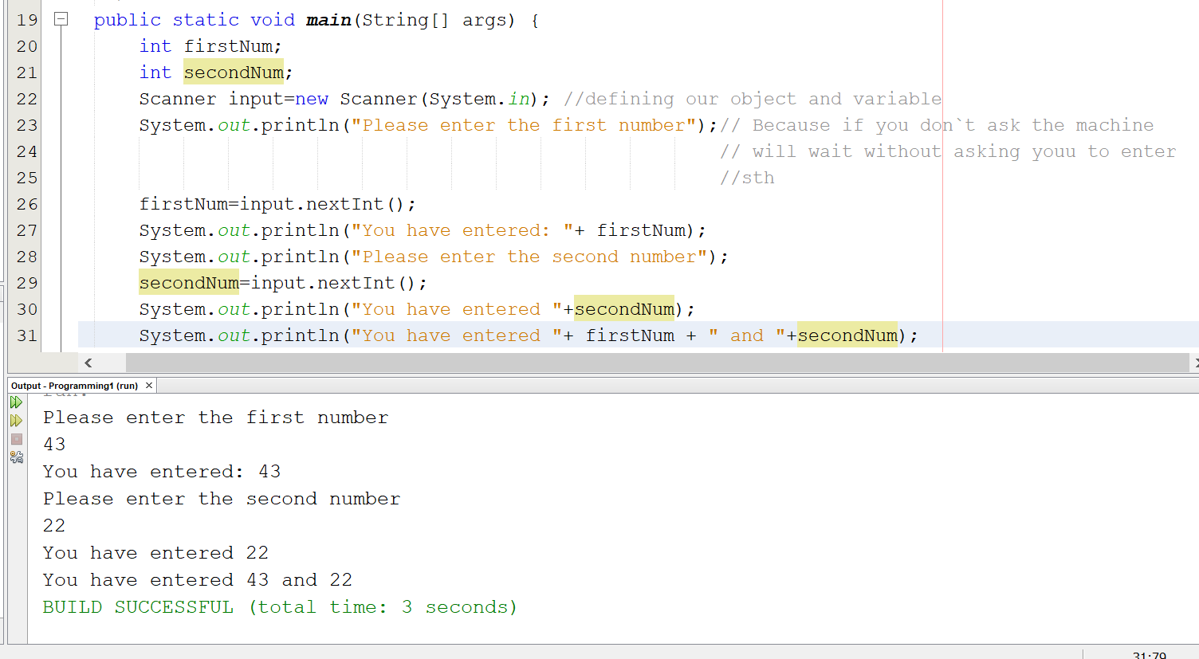
Input
Asking the user to input something is just common practice and to let them know that they should enter something. SO IT DOES NOT READ USING System.out.println()…

Slide 24
Reading Strings
Again you will need a scanner.
Again you need to tell the machine what you are going to put in the variable.
Scanner readSth=new Scanner(System.in);
String s=readSth.nextLine();

Slide 25
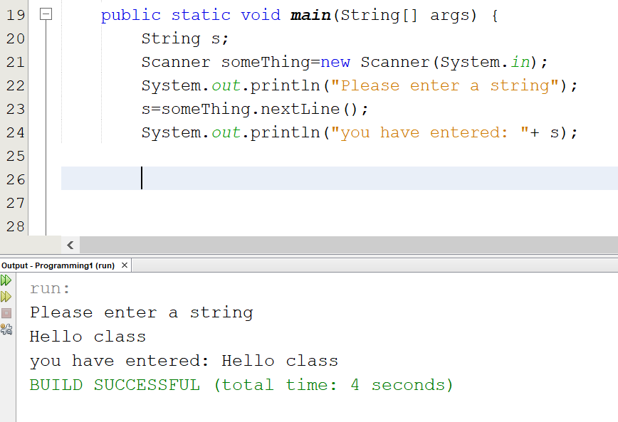
Read a String or a line
It will read until the user inputs a line that is until they press enter

Slide 26
Formatters
You can print your strings using different formats.
Add a tab between variables.
Print the double numbers with a certain number of decimals in front of them.
Add a line without using println
All this can be achieved using the printf() function. The first part is similar:
System.out.printf(“The format you want to print”, The things you want to print);

Slide 27
Some new commands
\n This is telling the machine to go to the next line to read input.
\t move 8 spaces or one tab further (moves the screen cursor there).
\\ used to print \ .
\” used to print ” .
%f : Read floating point number and doubles.
%s” Read Strings.
%d Read Integers.

Slide 28
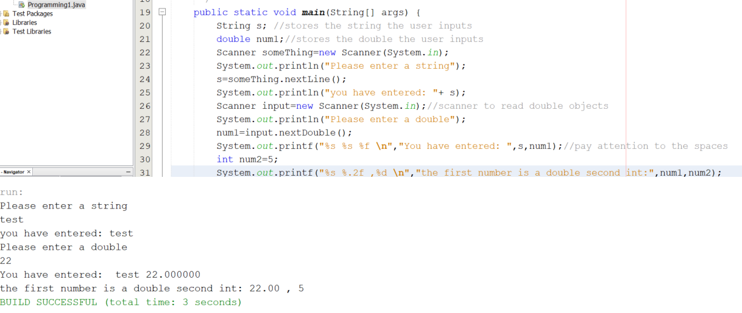
Formatters
Keep an eye on the spaces and commas.

Slide 29
Arithmetical operations
What you have learned in your algebra courses.
Operators are used to preform actions.
Each operator acts on specific elements and the output of this action depends on the type of elements it is acting on. Example:
2+4=6 For numbers it adds them
“Hello-” + “World”= “Hello-World”: For Strings it concatenates them. (will be explained in the future)

Slide 30
Number operators
Sum/Addition: 2+2=4;
Subtraction. 5-3=2;
Multiplication 2*2=4
Division 8/2=4. Twist with multiplication
Remainder 5%2=1, 9%4=1
= Assigns.

Slide 31
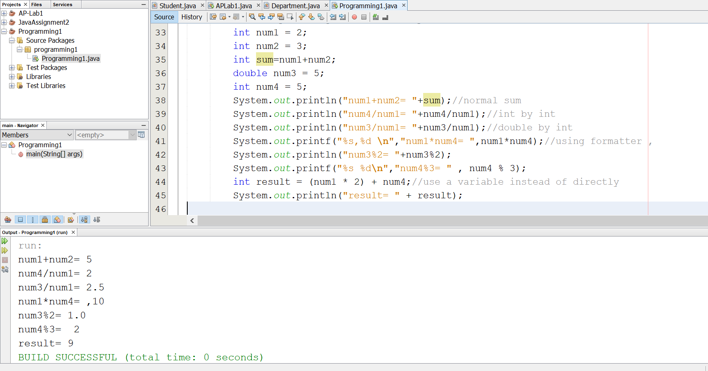
MAth
Pay attention to the comma used when using formatters and + in normal prints.
Pay attention that int/int will result in an integer
Int/double or double/int will result in a double number (like average that must be exact in your assignments).
The precedence of the operators matters.

Slide 32
The precedence of operators in Java
(): Whatever is in the parenthesis is computed first.
*, / , %: From Left to right: Multiplication, division, remainder
+ , -
What is the result of
6*(4+2)/2*(3+9)?
7*9-12/6+6%2?

Slide 33
summary
Syntax and semantic.
Different Error types .
Packages, Libraries.
Variables and their types.
Reading some input.
Formatters.
Arithmetic
Precedence of operators.

Slide 34
Next time
Some propositional logic
Logical Operators and their precedence combined with the assignment Operators.
The math class and random class and how to use them.
Introduction to control statements.

